Slide 1



AK Maju Business Management System
Pensyarah:
Assoc. Prof. Dr Haza Nuzly Bin Abdull Hamed
Dr. Aryati Binti Bakri
Ms. Rozilawati binti Dollah
Client:
Encik Noor Azam Bin Khalid
CEO AK MAJU Resources Sdn Bhd
PROJECT
AKMaju Business Management System

Slide 2



ALGOTECHIES
ONG YI YAN
GOH JIALE
TANG YAN QING
GROUP MEMBER
GROUP LEADER
GROUP MEMBER

Slide 3
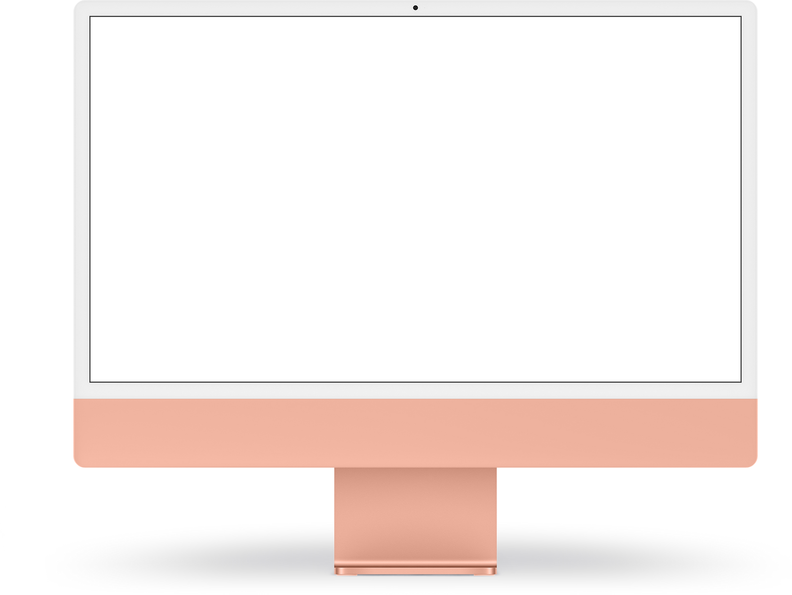
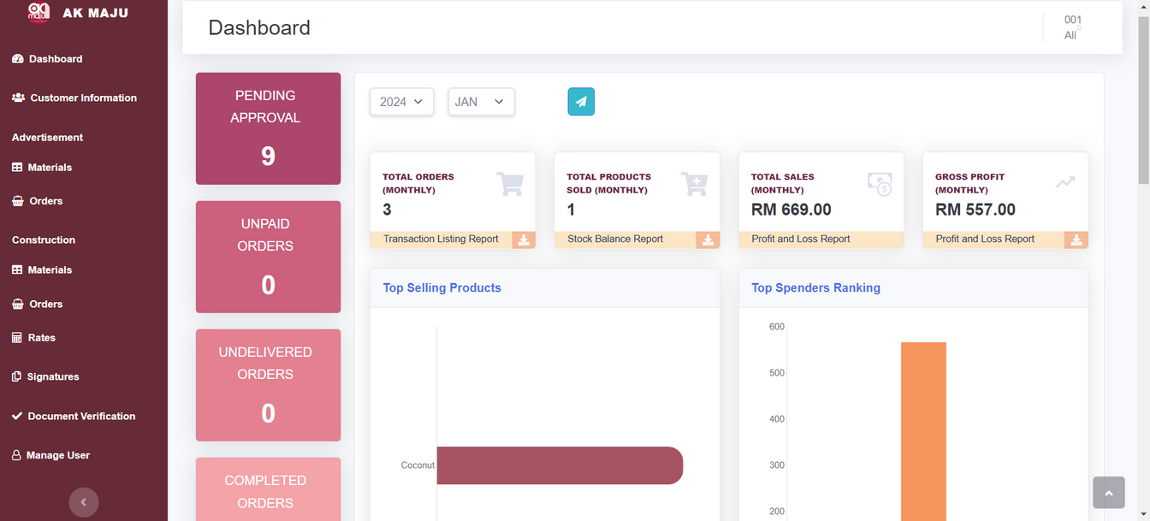
AK MAJU BUSINESS MANAGEMENT SYSTEM
Dashboard

Slide 4
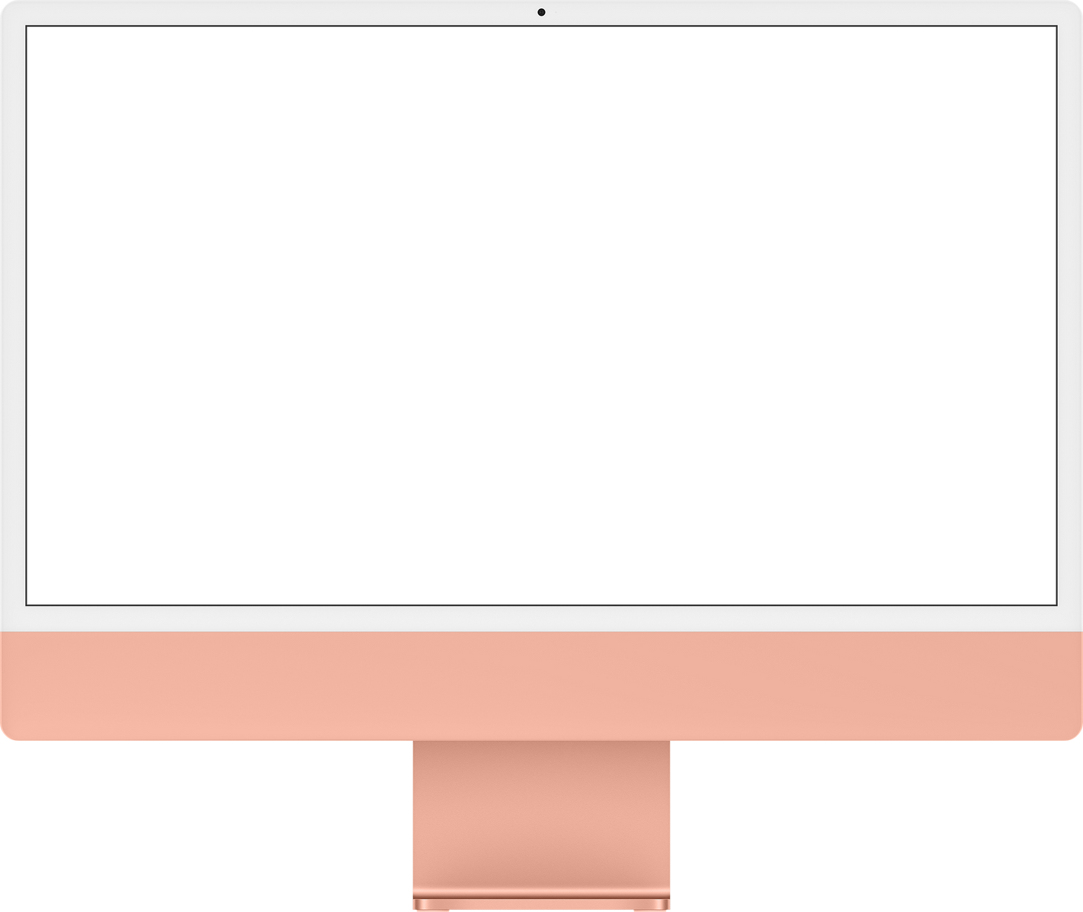
NO SHADOW
Monthly Report
User can view the summary of monthly report, download or send detailed monthly report based on selected year and month.
NEXT

Slide 5
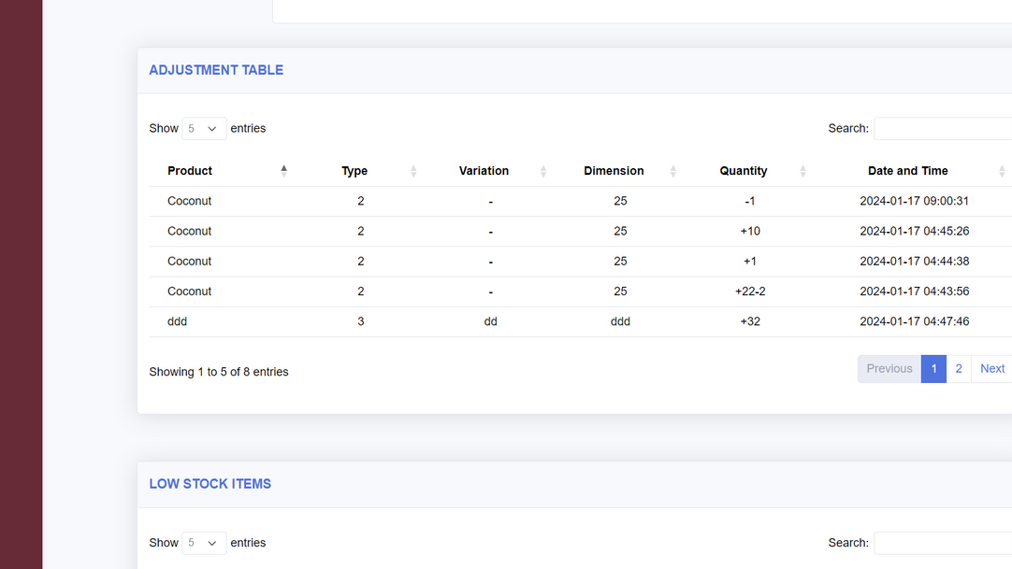
NO SHADOW
Adjustment Table
User can view the materials that that have been adjusted within the last 30 days.
NEXT

Slide 6
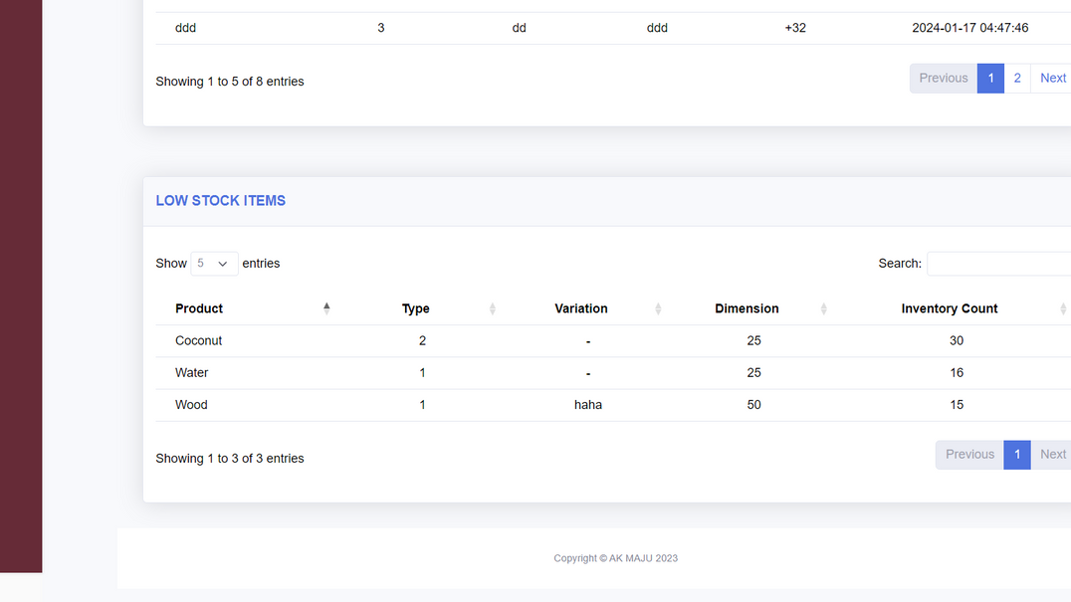
NO SHADOW
Low Stock Items Table
User can view the low stock items.
NEXT

Slide 7
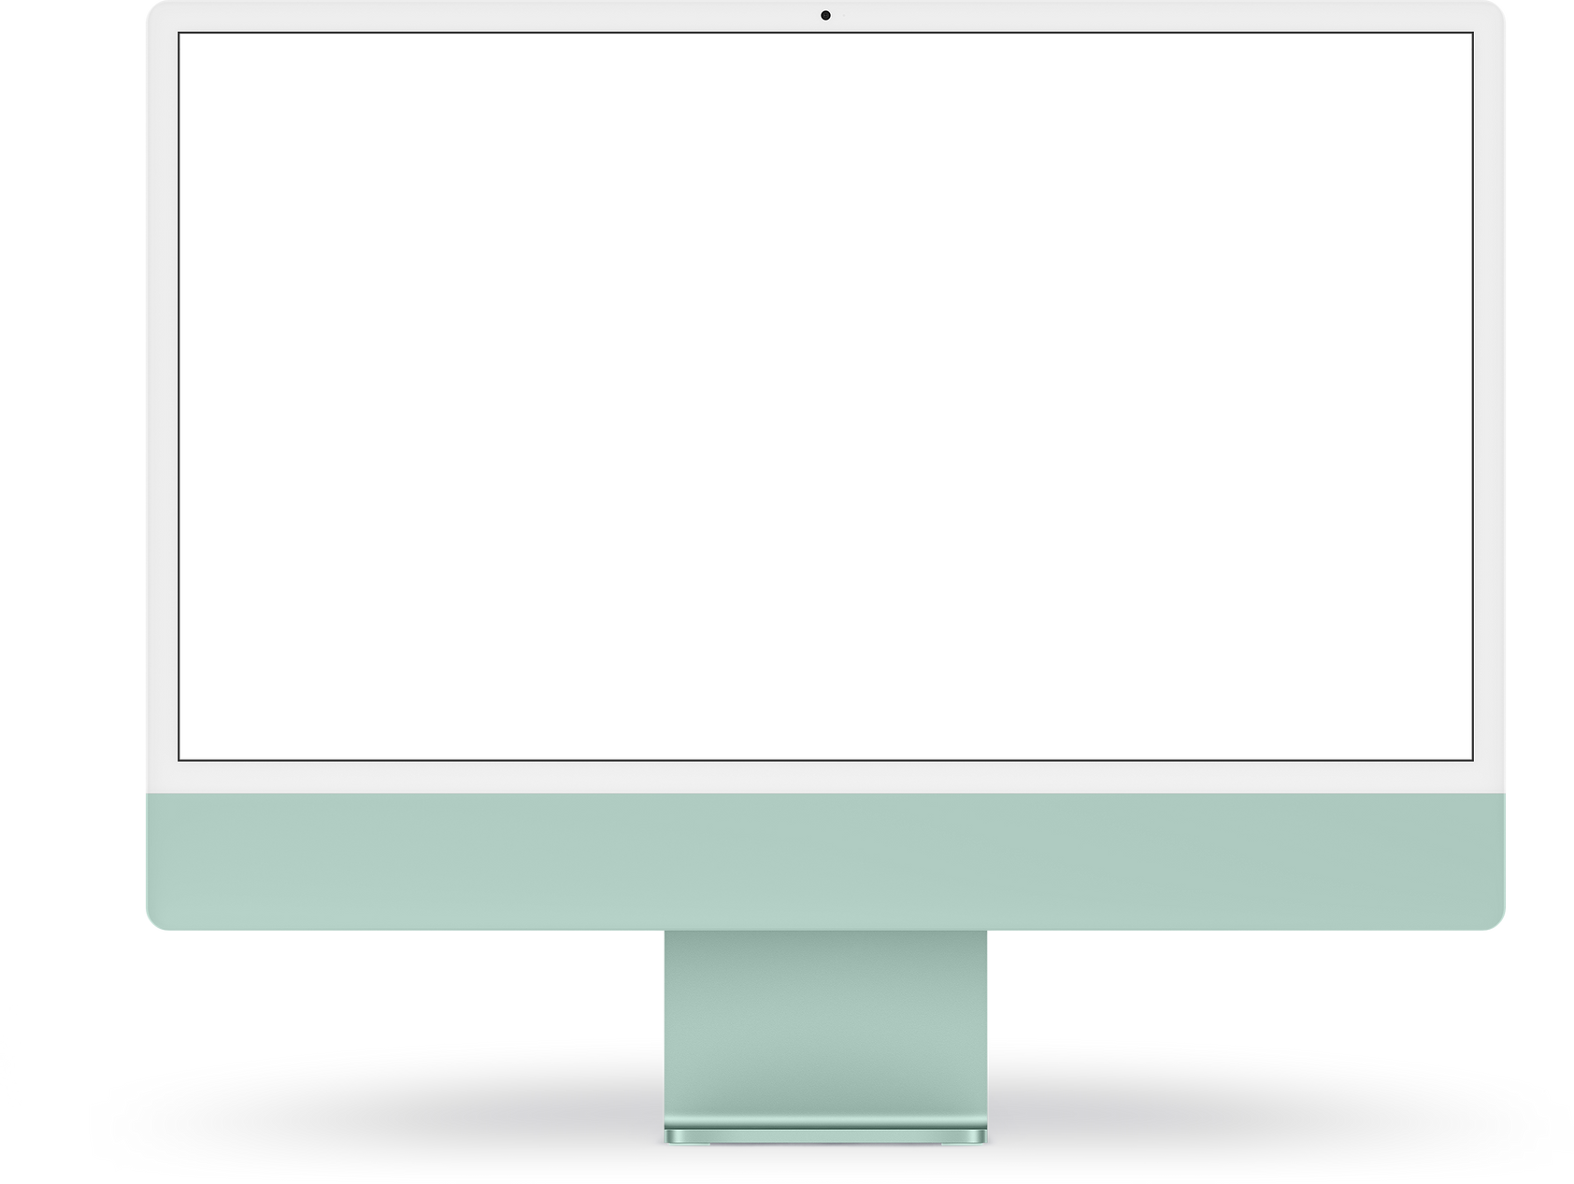
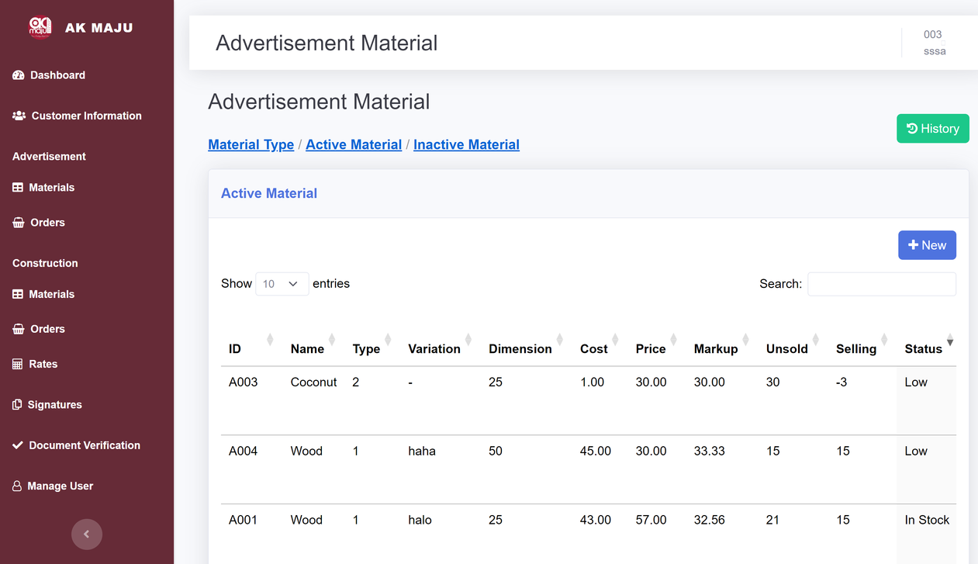
AK MAJU BUSINESS MANAGEMENT SYSTEM
Material
Management

Slide 8
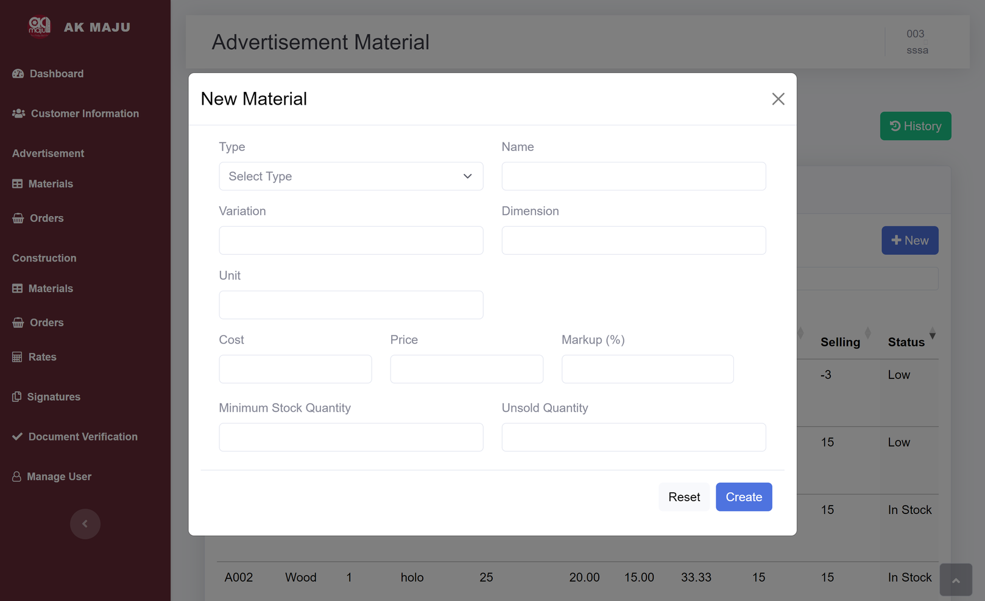
DESK SHADOW
Create New Material
User needs to insert material type, name, unit, dimension, variation, cost, price ,quantity of new material.
NEXT

Slide 9
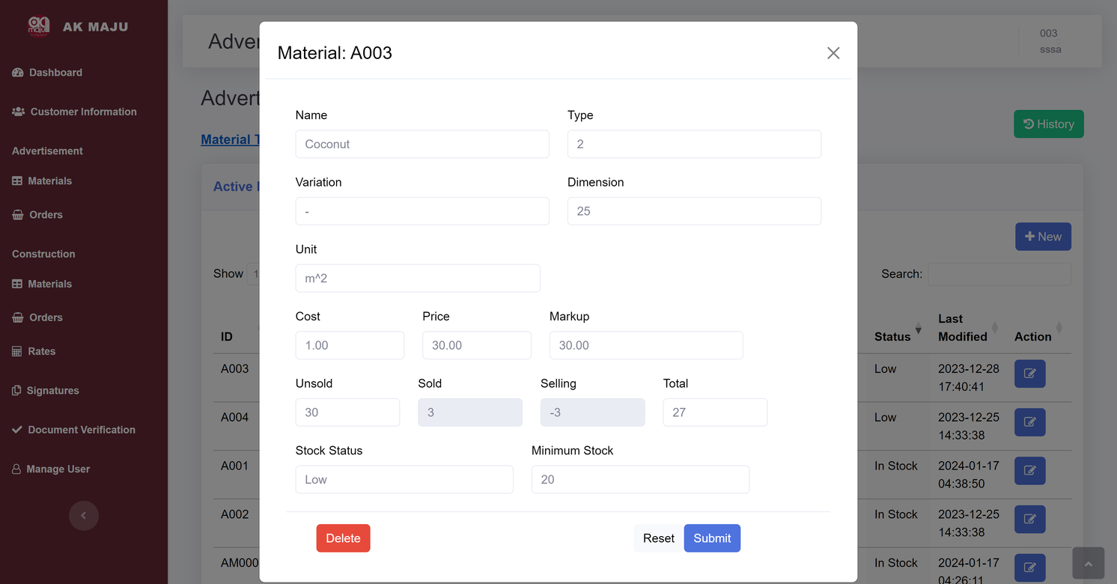
DESK SHADOW
Edit Existing Material
User can edit material type, name, unit, dimension, variation, cost, price ,quantity of existing material.
NEXT

Slide 10
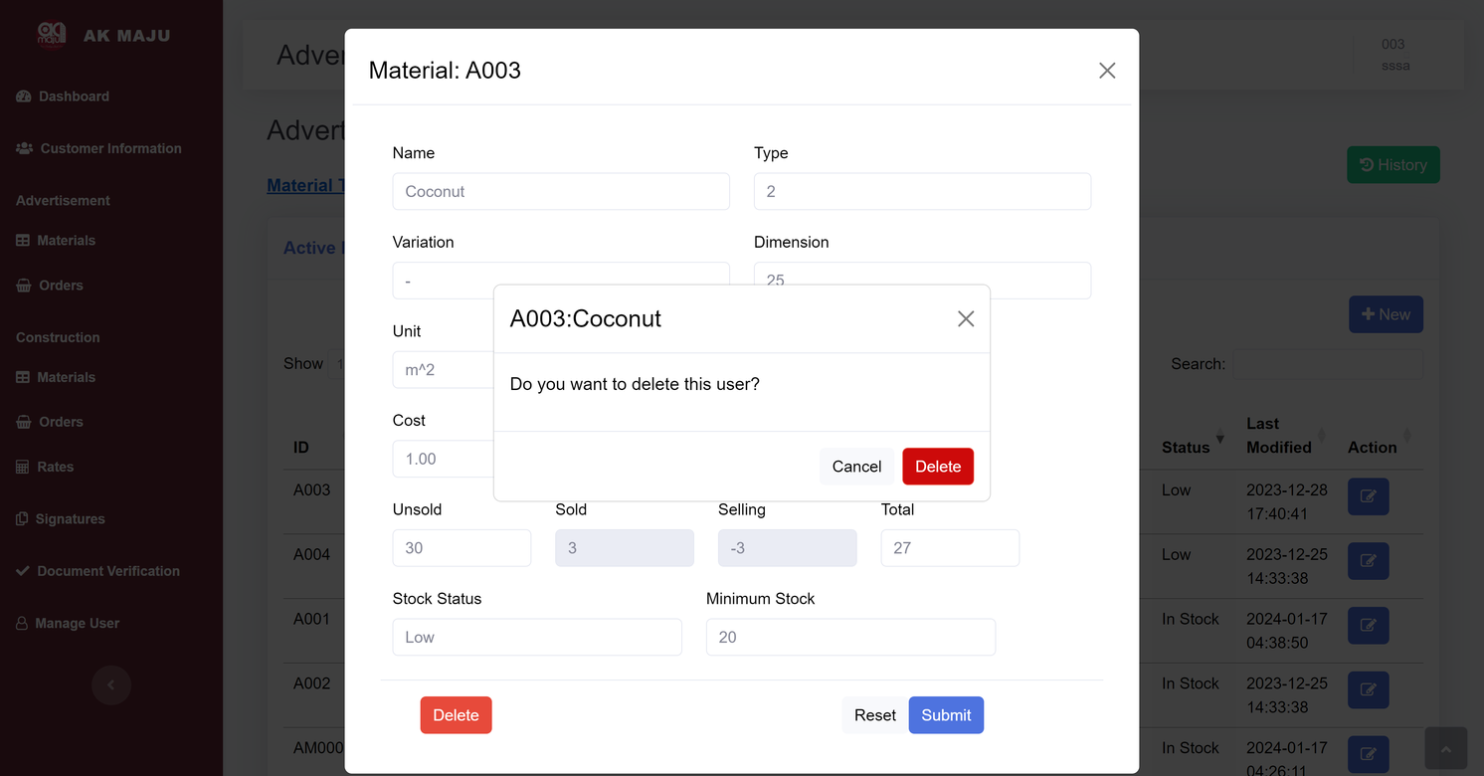
DESK SHADOW
Delete Material
The deleted material will be displayed in ‘Inactive Material’ table.
NEXT

Slide 11
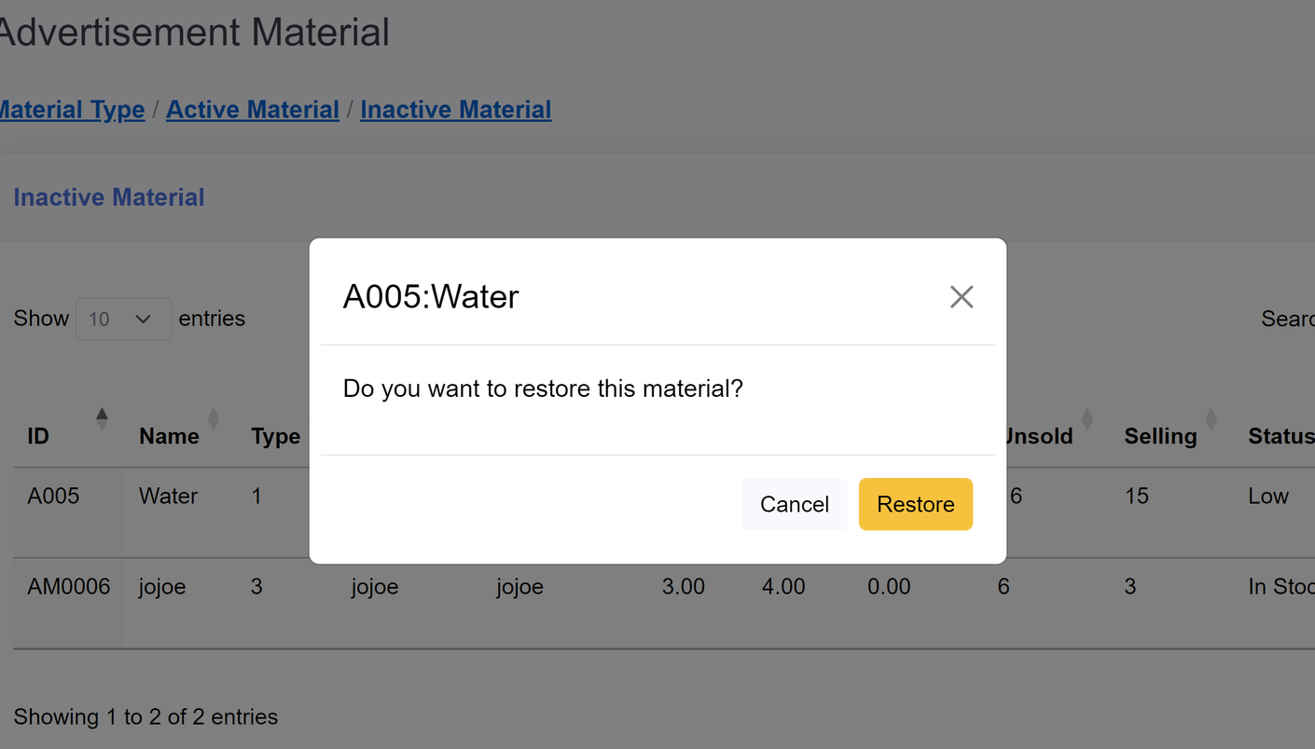
DESK SHADOW
Restore Material
Delete your material accidentally? No worries we got you.
NEXT

Slide 12
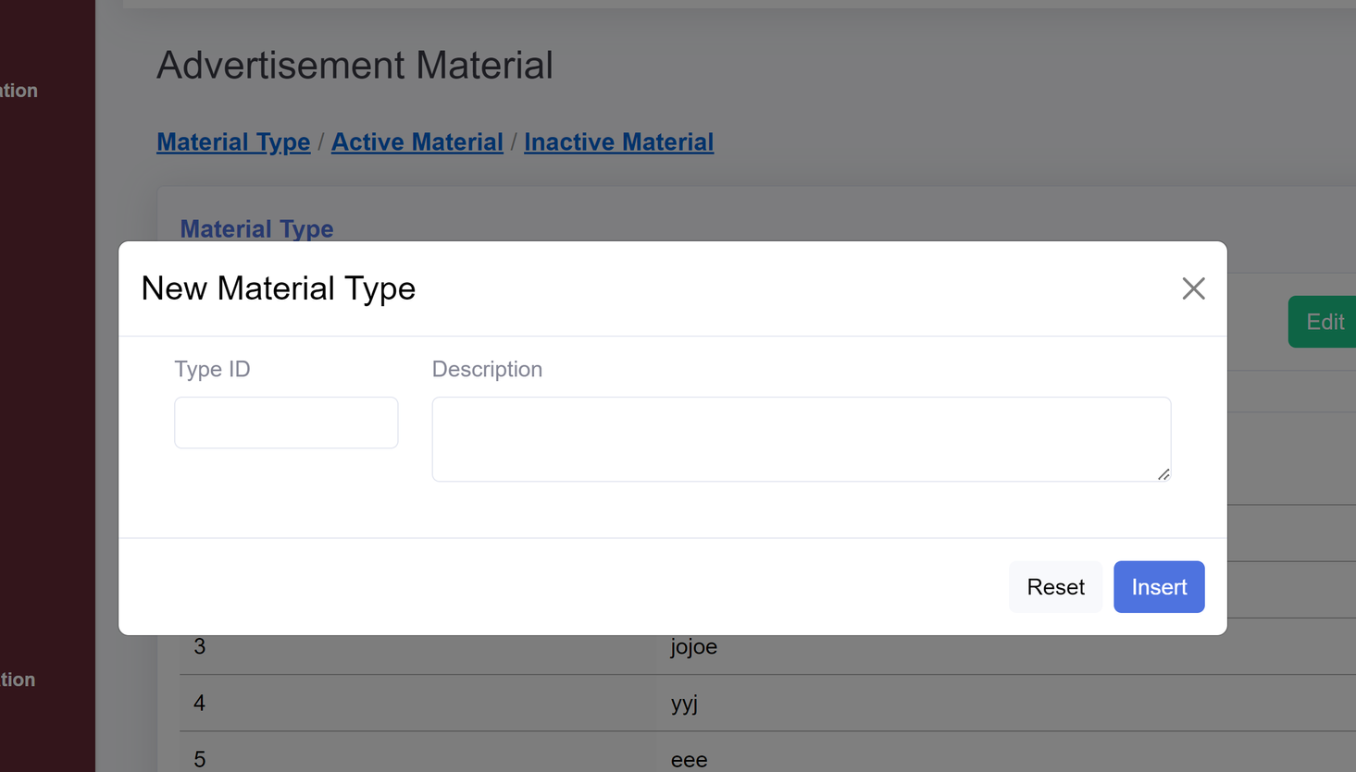
DESK SHADOW
Add Material Type
Just type in type ID and its description
NEXT

Slide 13
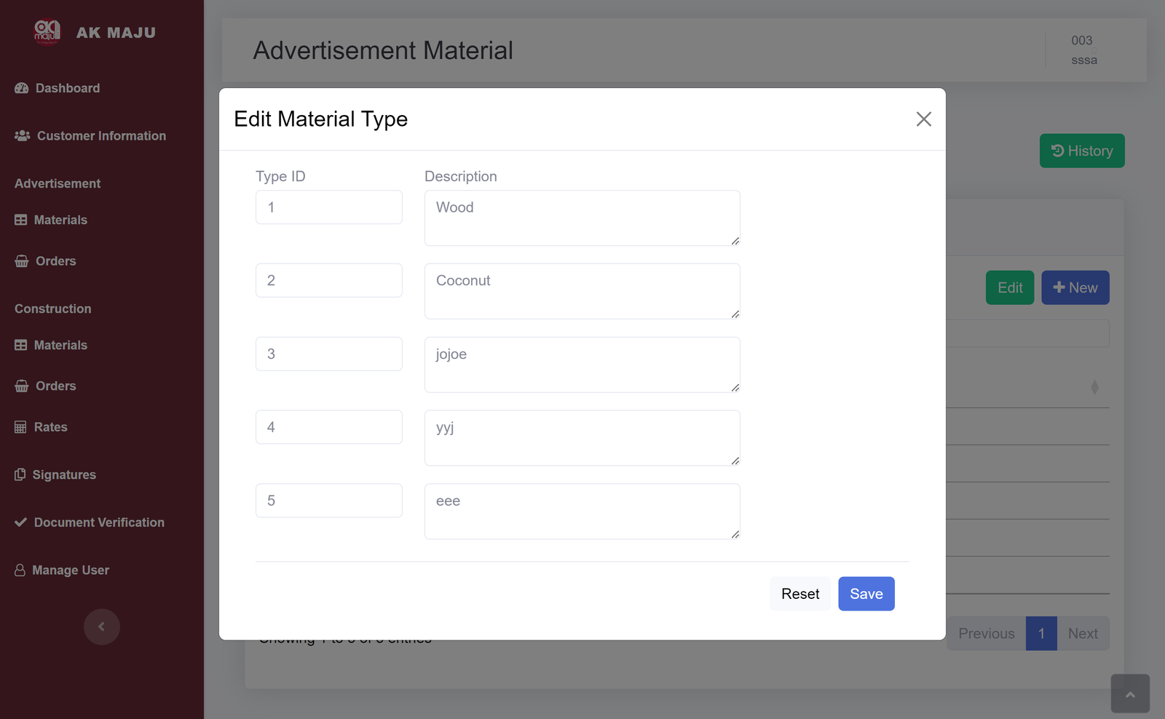
DESK SHADOW
Edit Material Type
Feel free to edit the description of material type.
NEXT

Slide 14

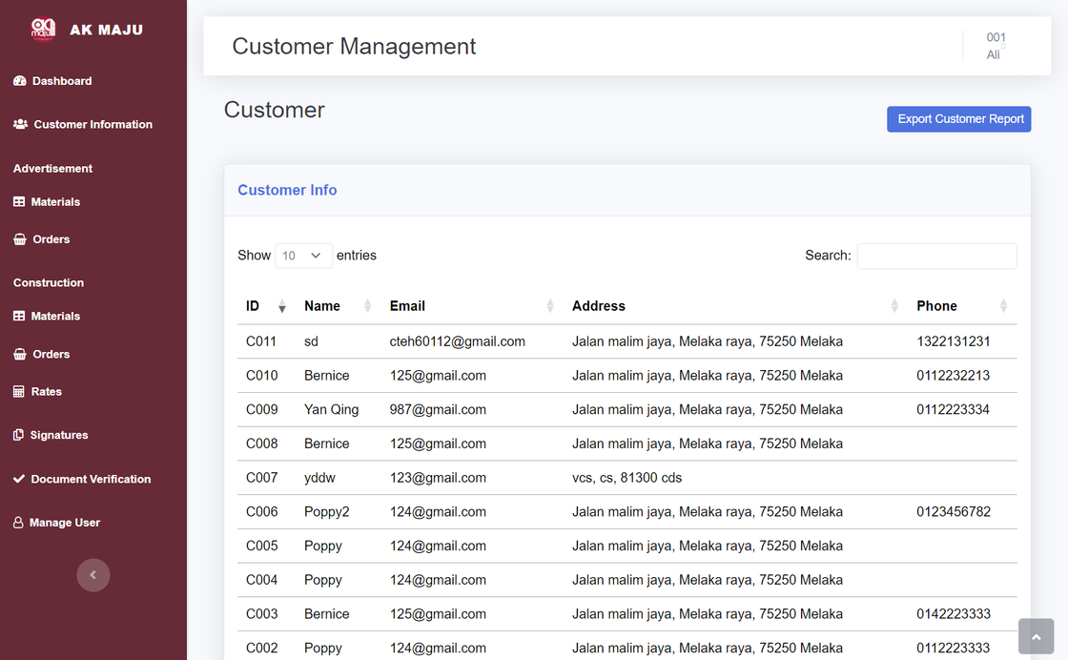
WEBSITE MOCKUPS
Customer Information

Slide 15
DESK SHADOW
Customer Info Table
User can view the customer information in Customer Page
NEXT

Slide 16
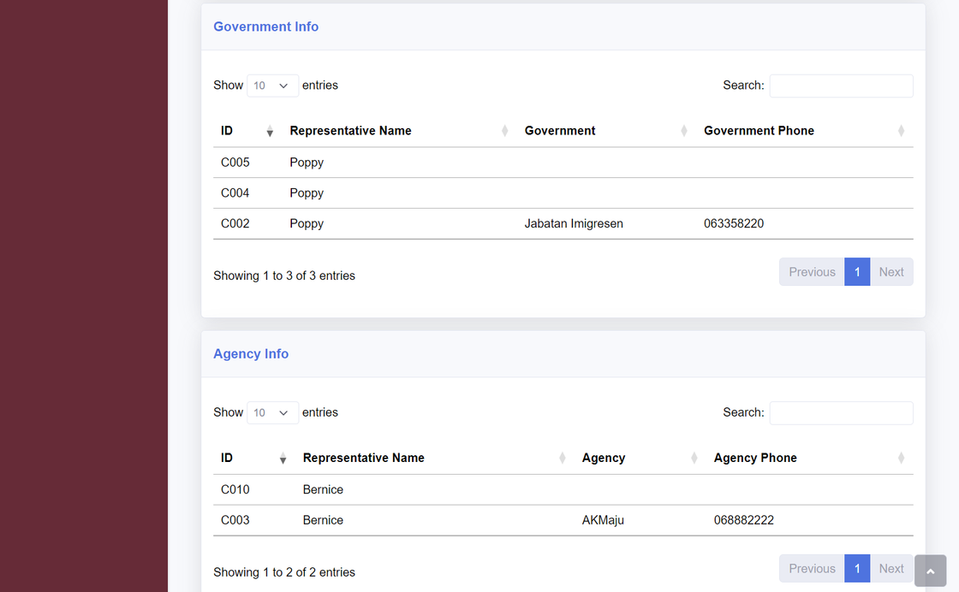
DESK SHADOW
Customer Information
User can also view the government and agency information if the customer is the representative of government or agency
NEXT

Slide 17
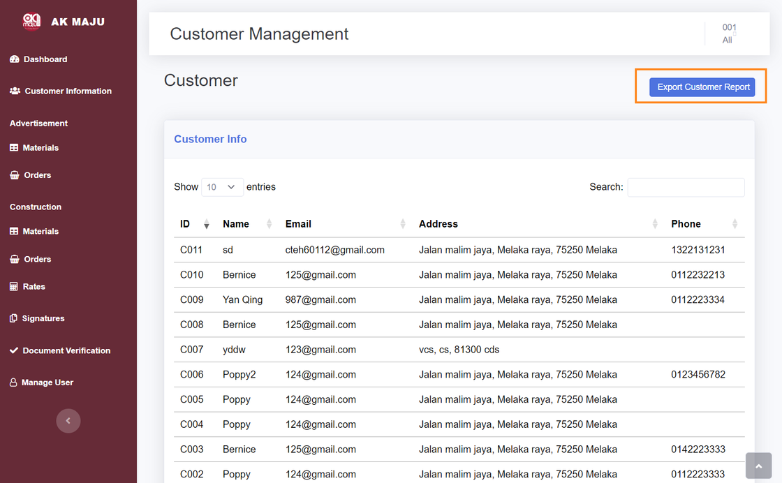
DESK SHADOW
Export Customer Information
Admin can export customer information based on range of order date.
NEXT

Slide 18
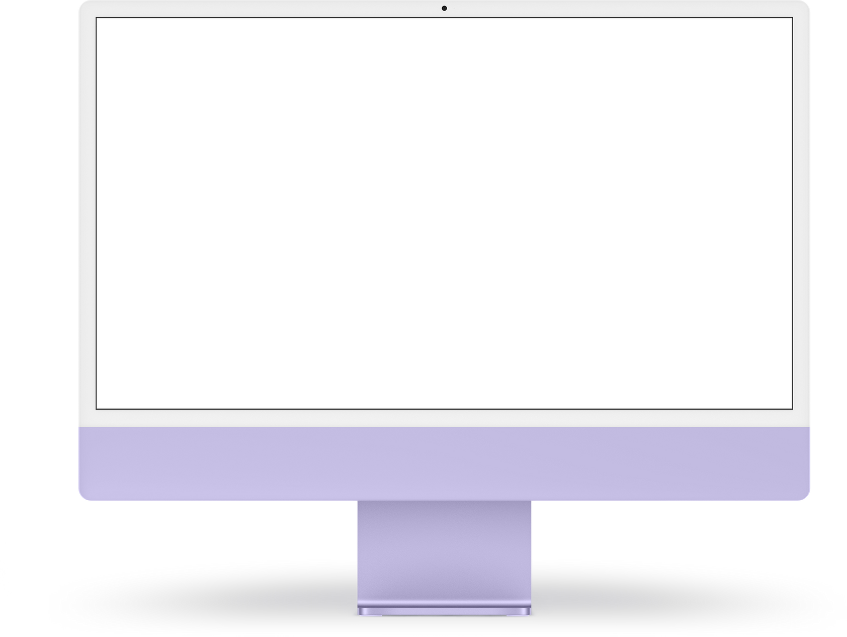
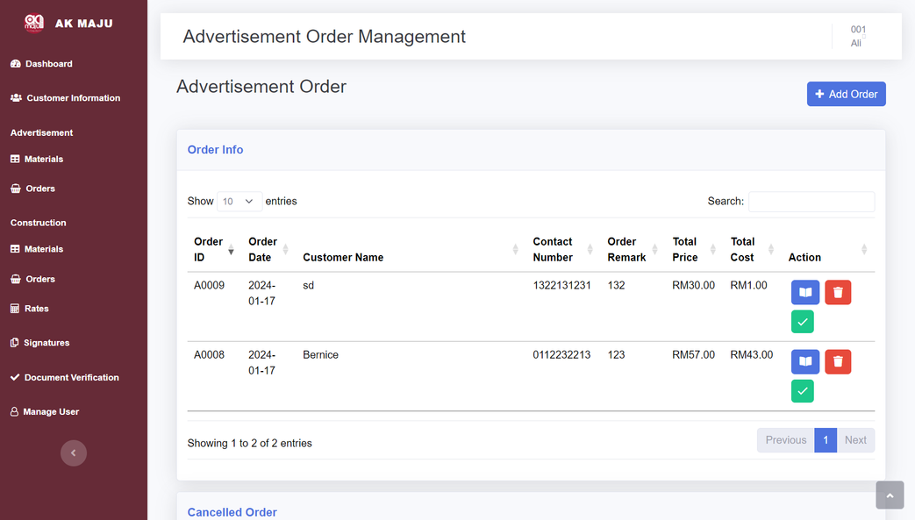
WEBSITE MOCKUPS
Order Management

Slide 19
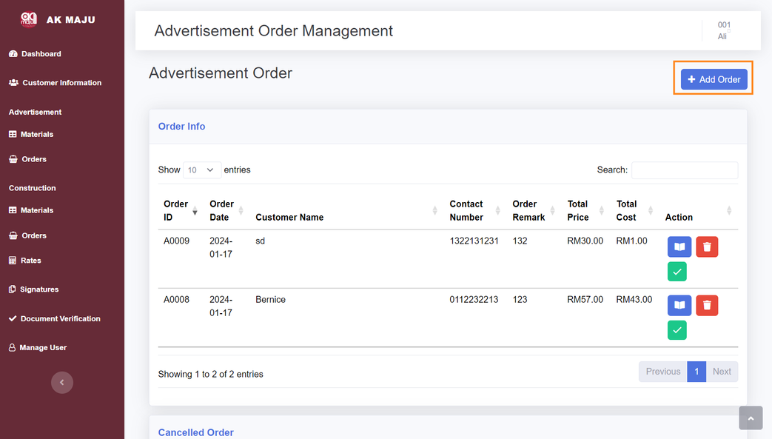
DESK SHADOW
Add Order
User can click on Add Order button at the right top to add new order
NEXT

Slide 20
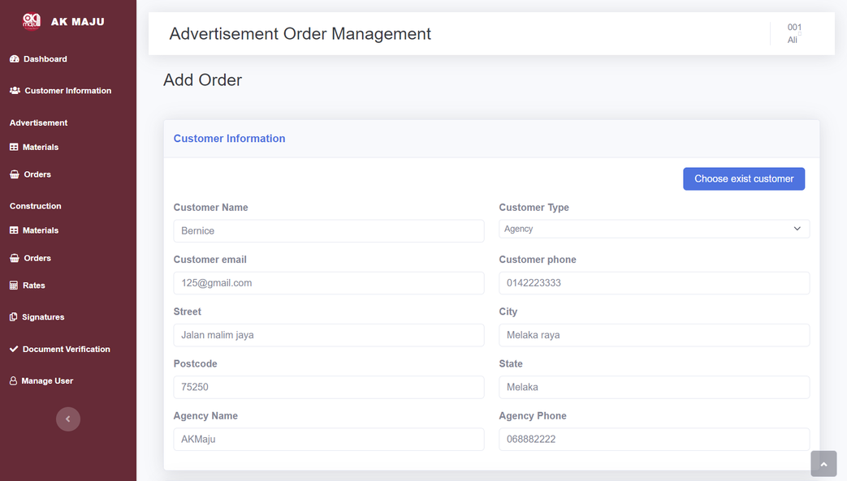
DESK SHADOW
Add Customer Information
User need to fill in customer information or can choose exist customer by click on button “Choose Exist customer”
NEXT

Slide 21
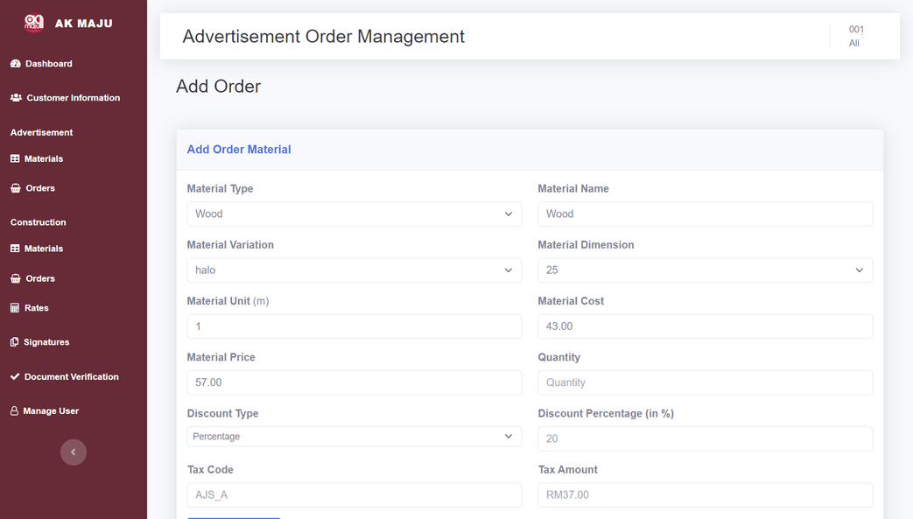
DESK SHADOW
Add Order Material
User can click on Add Order new order material by fill in material details.
NEXT

Slide 22
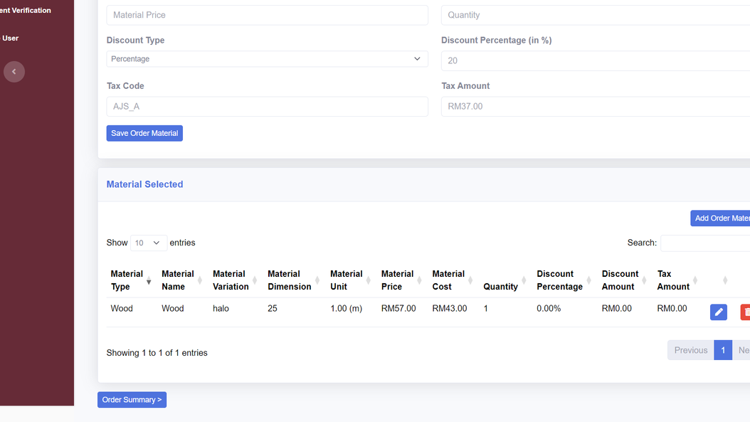
DESK SHADOW
View and Manage Order Material
User can view, edit and delete Order Material in Material Selected table.
NEXT

Slide 23
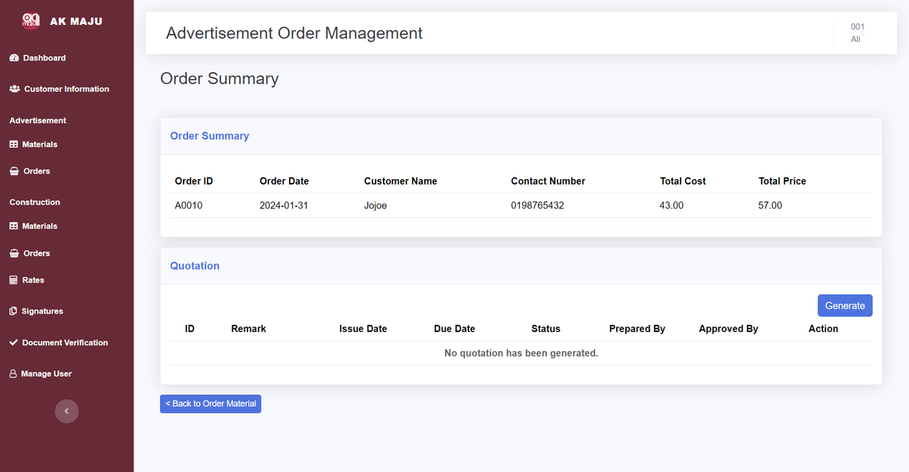
DESK SHADOW
Order Summary Page
User can view order summary and generate quotation
NEXT

Slide 24
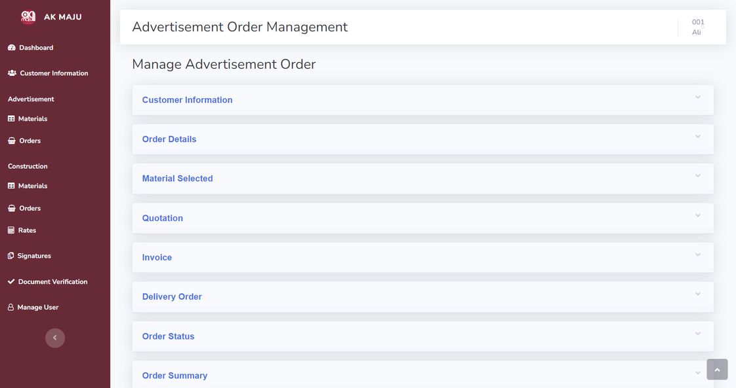
DESK SHADOW
Edit Order
User can Manage Order Details for each order
NEXT

Slide 25
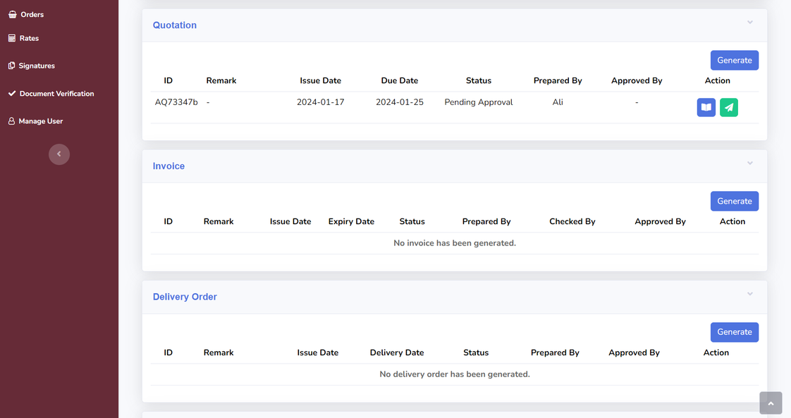
DESK SHADOW
Quotation, Invoice and Delivery Order
User can generate, view and send email for quotation, invoice and delivery order.
NEXT

Slide 26
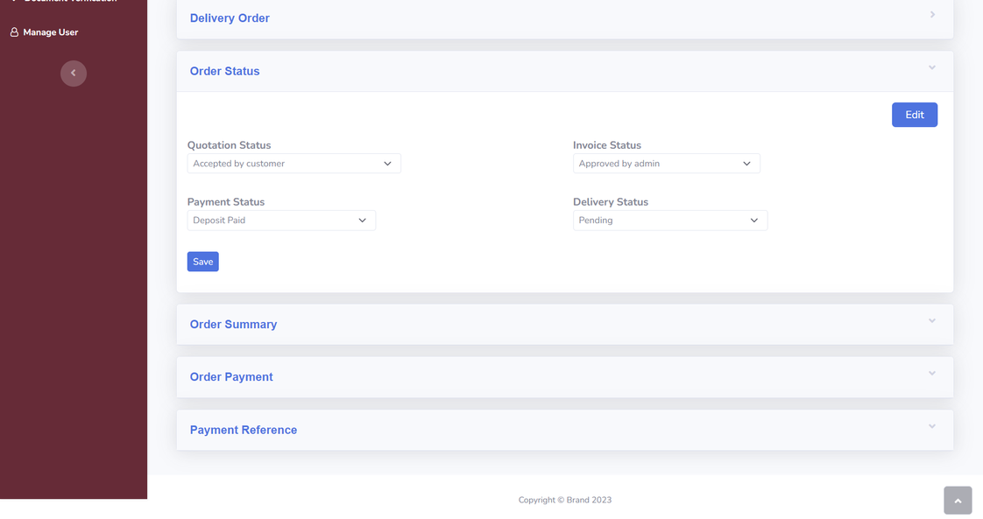
DESK SHADOW
Order Status
User can manage quotation, invoice, payment and delivery status for each order.
NEXT

Slide 27
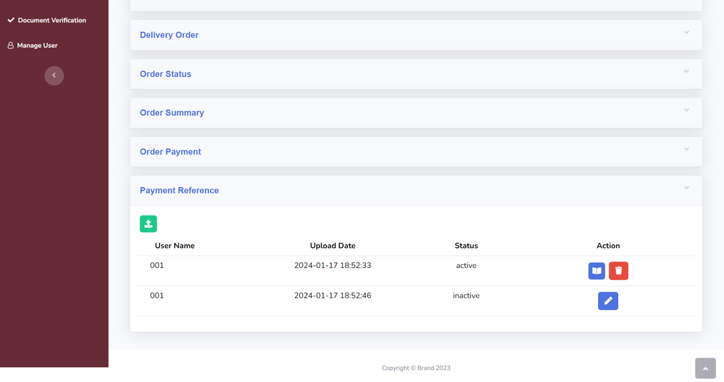
Only Advertisement Order :
DESK SHADOW
Payment Reference
User can upload, view, delete and restore payment reference.
NEXT

Slide 28
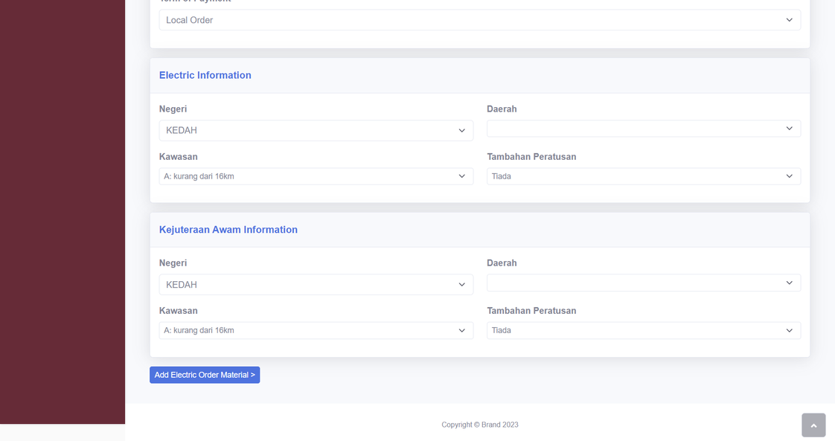
Only Construction Order :
DESK SHADOW
Electric and Kejuruteraan Awam Information
User can enter electric and kejuruteraan awam (civil) information, such as state, region, distance from JKR Electric, and any add-on percentage due to transport problem.
NEXT

Slide 29
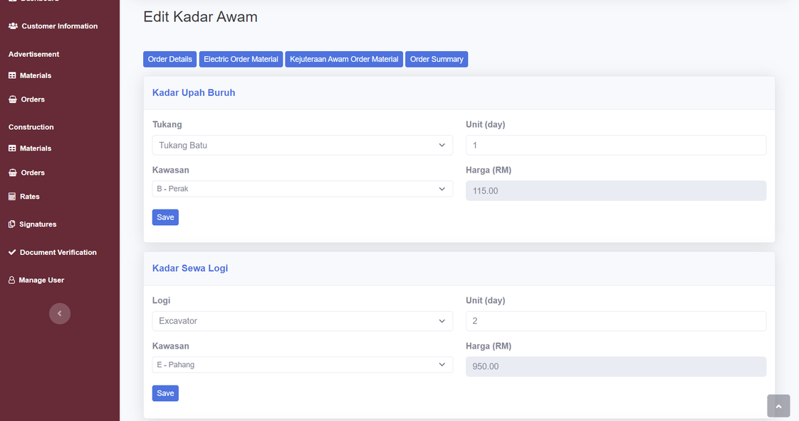
Only Construction Order :
DESK SHADOW
Order rate for labor and worker's salary
User can enter labor and worker’s information to calculate their salary.
NEXT

Slide 30
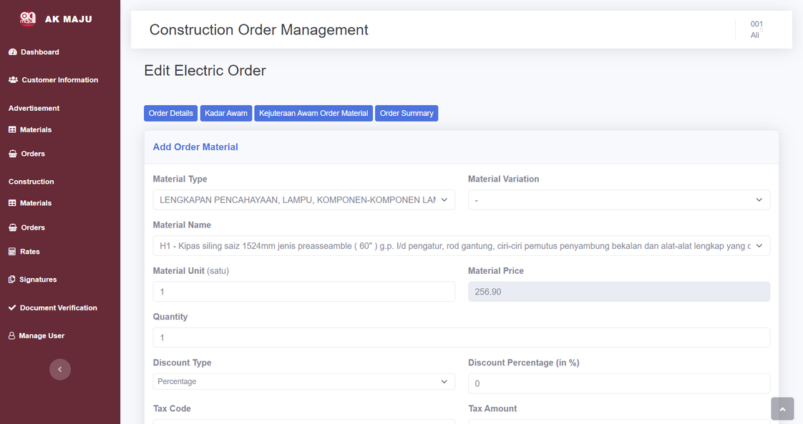
Only Construction Order :
DESK SHADOW
Electric Order Material
User can enter electric order material for construction order.
NEXT

Slide 31
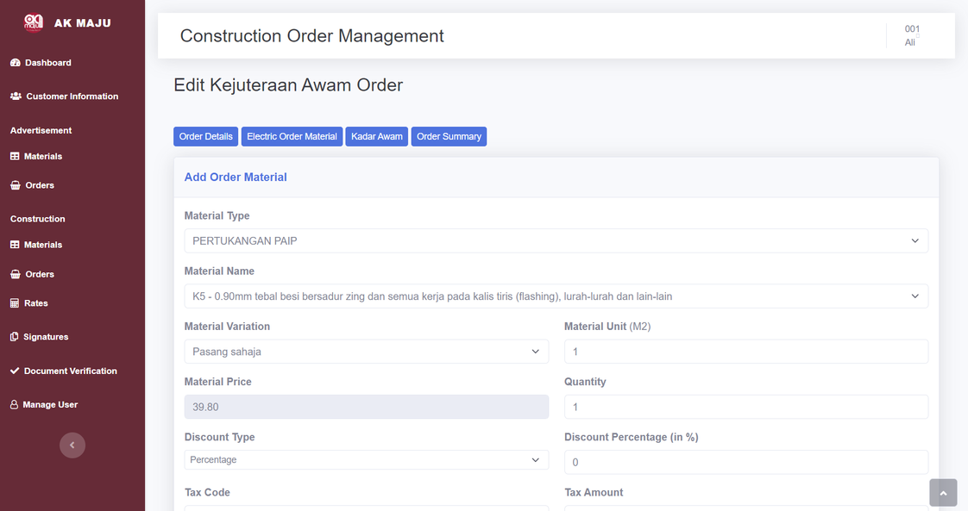
Only Construction Order :
DESK SHADOW
Kejuruteraan Awam Order Material
User can enter kejuruteraan order material for construction order.
NEXT

Slide 32
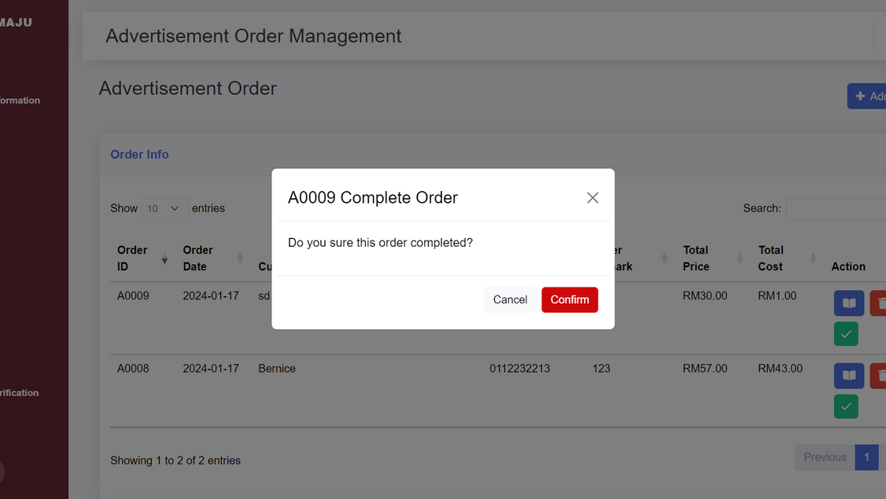
DESK SHADOW
Complete Order
User can complete order by click on green tick button.
NEXT

Slide 33
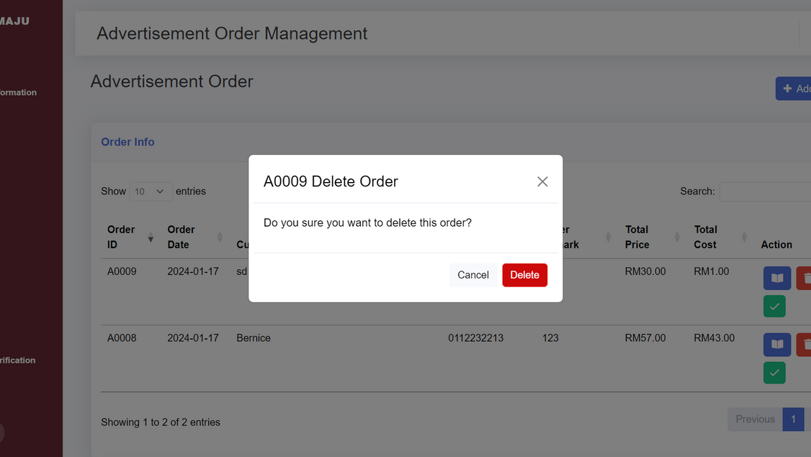
DESK SHADOW
Delete/Cancel Order
User can delete order by click on red trash button.
NEXT

Slide 34
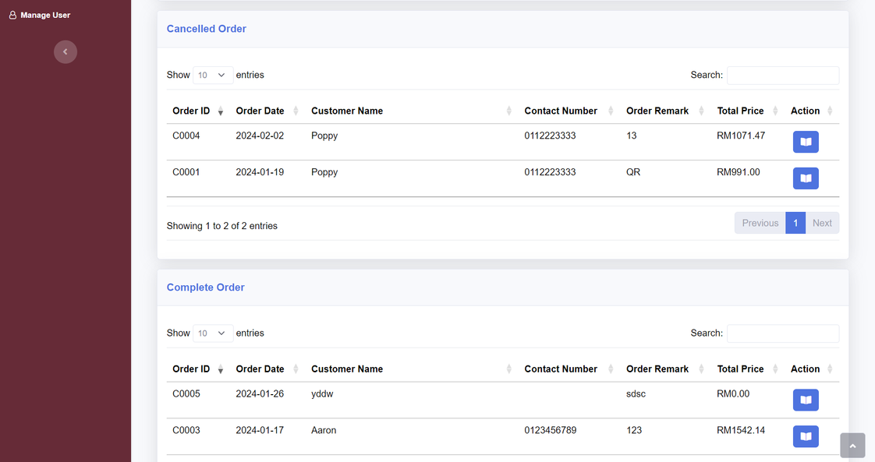
DESK SHADOW
Complete and Cancelled Order Table
User can view complete and cancelled order table in order main page and view order details of them.
NEXT

Slide 35
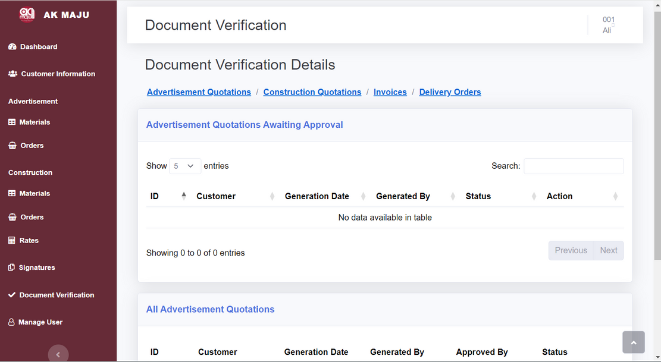
AK MAJU BUSINESS MANAGEMENT SYSTEM
Document Verification

Slide 36
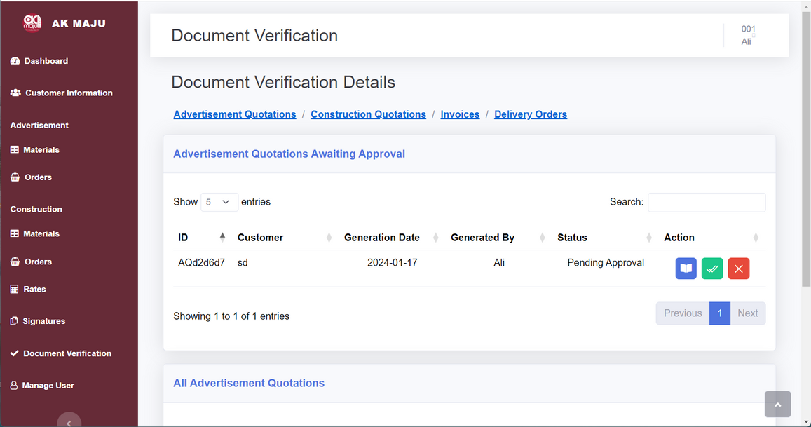
DESK SHADOW
Approve/Reject Document
Admin can approve/reject the generated advertisement quotations, construction quotations, invoices and delivery orders
NEXT

Slide 37
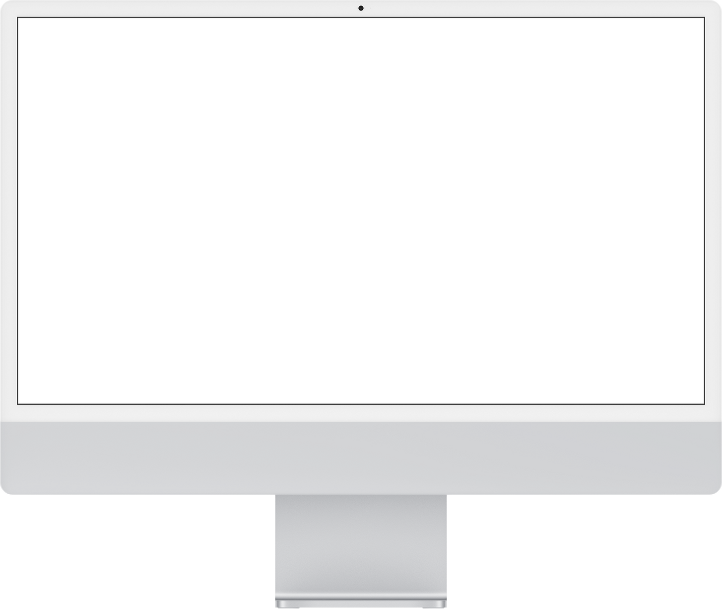
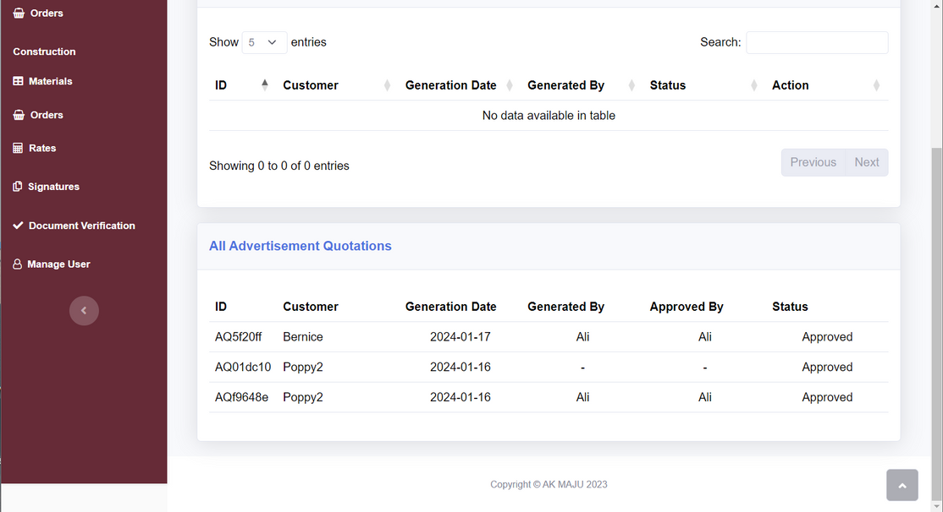
NO SHADOW
View All Generated Document
User can view all the generated advertisement quotations, construction quotations, invoices and delivery orders
NEXT

Slide 38
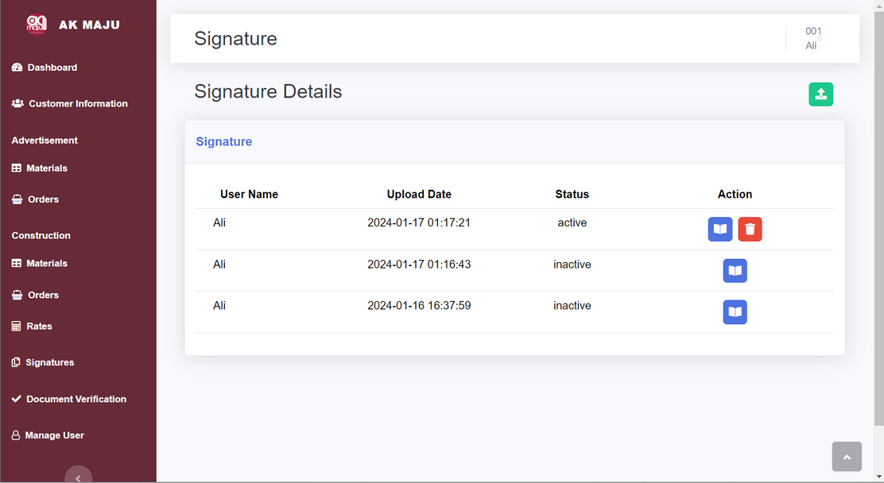
AK MAJU BUSINESS MANAGEMENT SYSTEM
Signature

Slide 39
DESK SHADOW
Manage Signature
User can view, upload and delete the signature that has been uploaded
NEXT

Slide 40
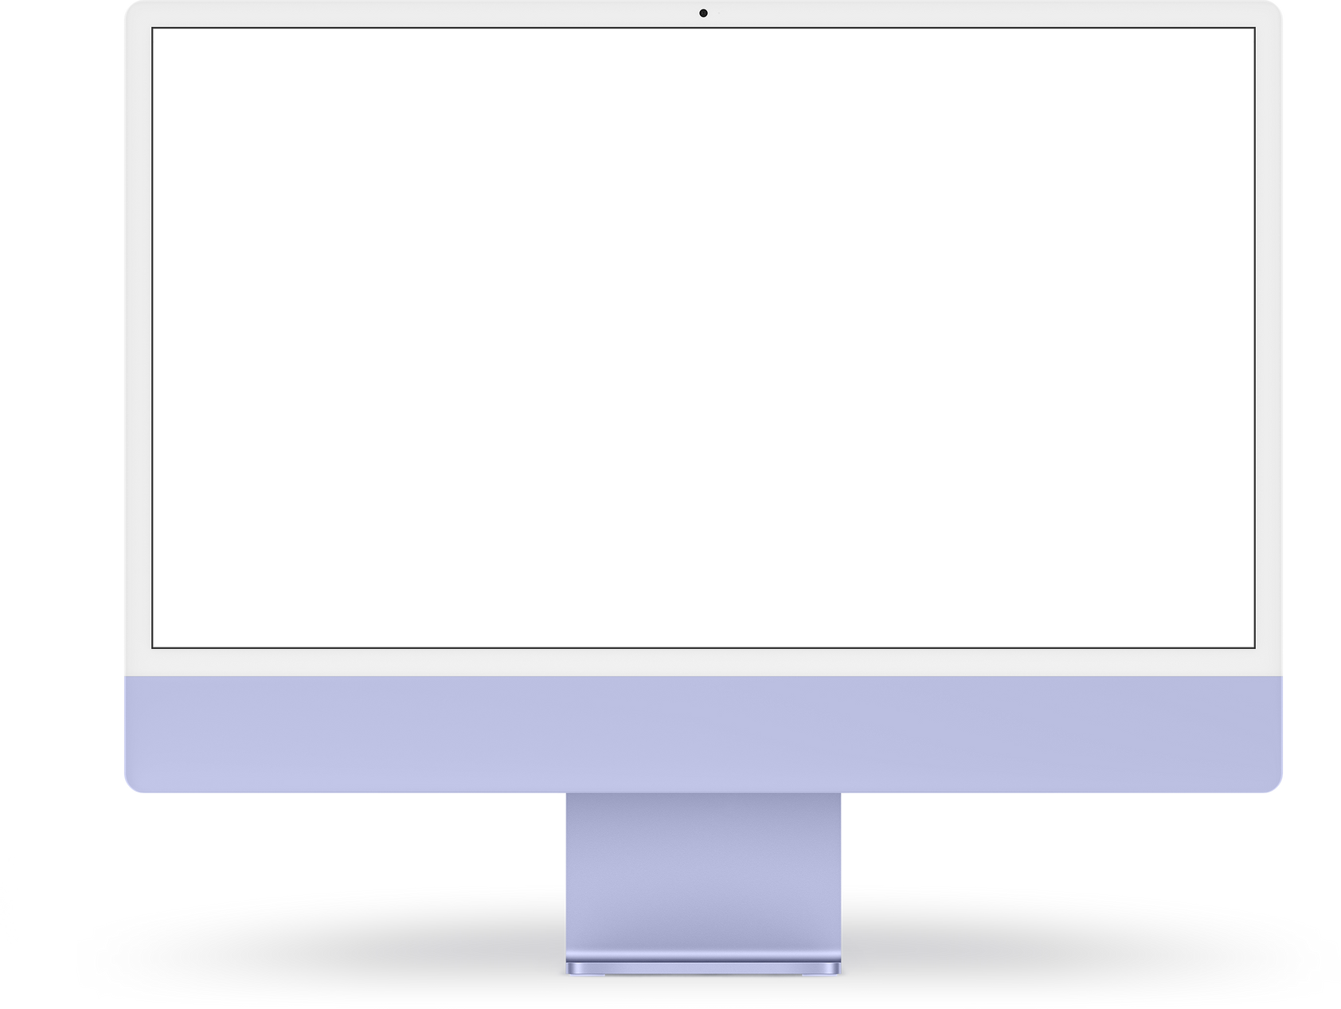
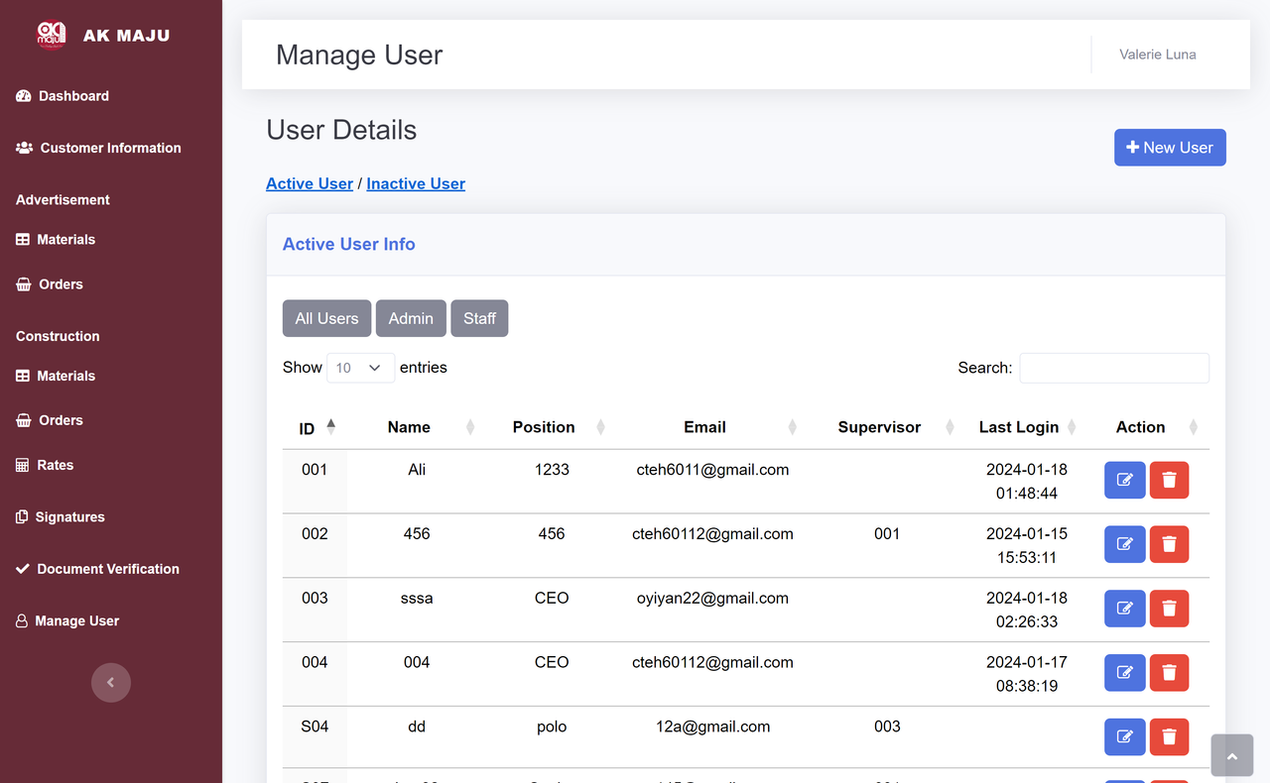
WEBSITE MOCKUPS
Manage User

Slide 41
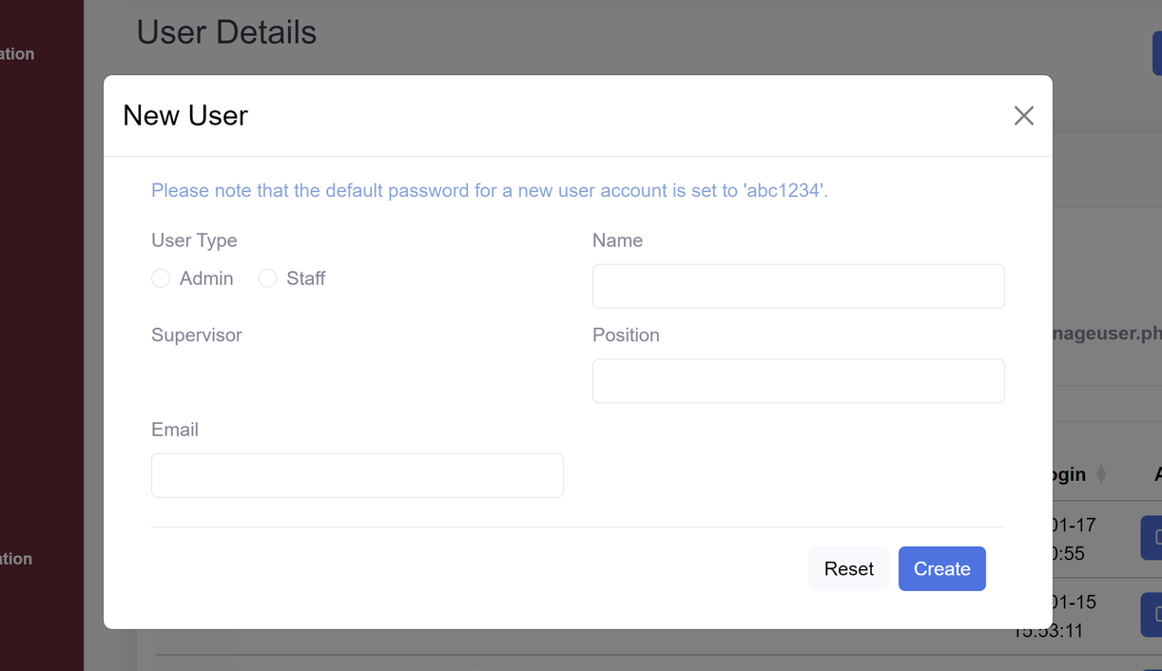
DESK SHADOW
Create
New User
Select the user type and type in their information.
NEXT

Slide 42
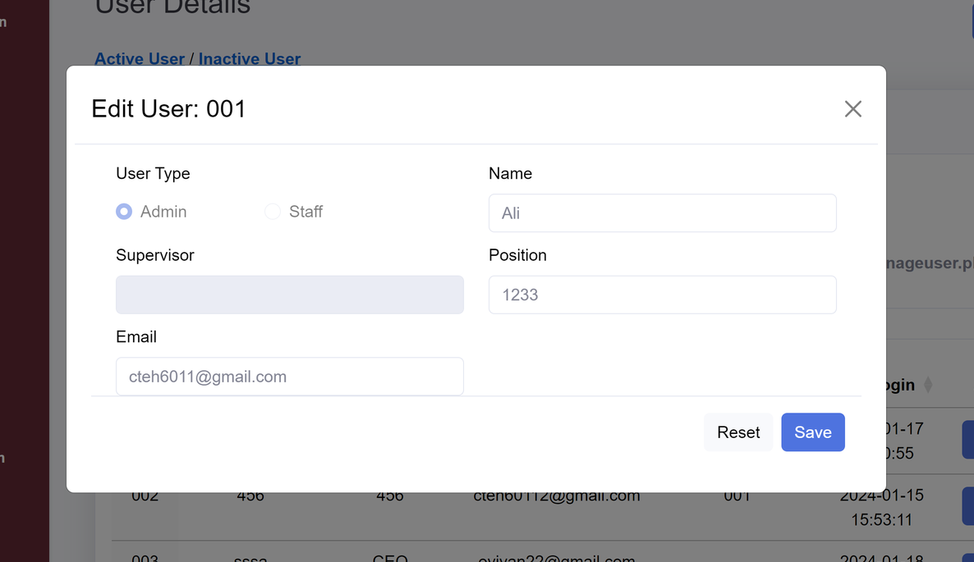
DESK SHADOW
Edit Existing User
Edit the user information.
NEXT

Slide 43
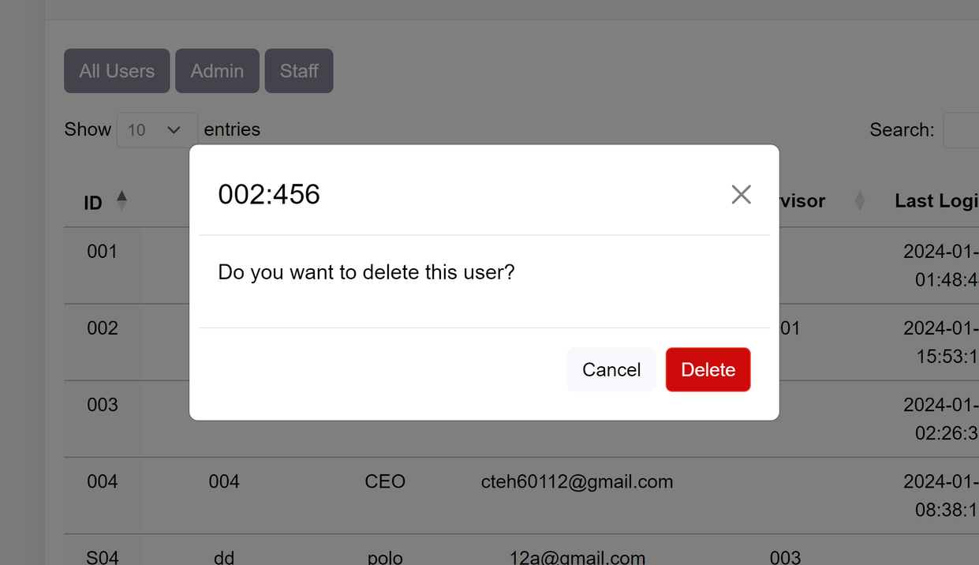
DESK SHADOW
Delete
User
Delete the inactive user
NEXT

Slide 44
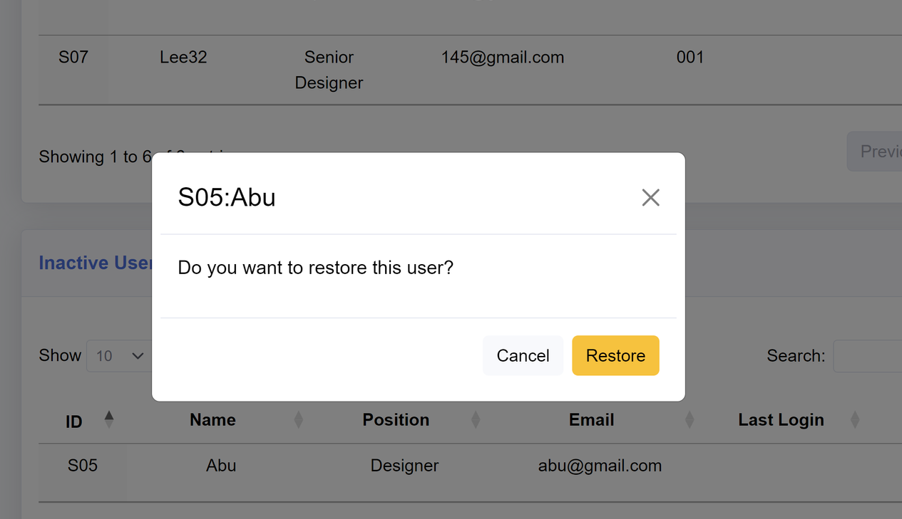
DESK SHADOW
Restore
User
Delete a user accidentally?
No worries we got you.
NEXT

